Slide 1





A
B
C
D
E
Introduction
Aims & Objectives
Research
Future Works
Conclusion
IoT Based Smart Irrigation System
Introduction about our project’s concept that connects everyday objects and devices to the internet enabling automated data collection.
The phases about a developed IoT-Based Smart Agricultural System using various gadgets to create a system for farmers works less.
The main aims and objectives of developing an IoT-based smart agricultural system to help farmers automate agricultural tasks in a very easy way.
The future of IoT-Based agricultural system that improves day by day on integrating wireless connectivity like Wi-Fi or GSM allowing to monitor it.
Adoption of IoT in agriculture explains a significant step towards modernizing traditional farming practices by utilizing real time data from sensors.
Presentation

Slide 2
A
B
C
D
E
Introduction
Aims & Objectives
Research
Future Works
Conclusion
IoT Based Smart Irrigation System
Introduction about our project’s concept that connects everyday objects and devices to the internet enabling automated data collection.
The main aims and objectives of developing an IoT-based smart agricultural system to help farmers automate agricultural tasks in a very easy way.
The phases about a developed IoT-Based Smart Agricultural System using various gadgets to create a system for farmers works less.
The future of IoT-Based agricultural system that improves day by day on integrating wireless connectivity like Wi-Fi or GSM allowing to monitor it.
Adoption of IoT in agriculture explains a significant step towards modernizing traditional farming practices by utilizing real time data from sensors.
Presentation

Slide 3
Introduction
Project Green [Group members]
Erick Pradhan (Leader)
Papit Ghimire
Sangam Pandey
Saket Yadav

Slide 4
Aims & Objectives
The main aim of our project is to develop an IoT-Based smart agricultural system to help farmers automate agricultural tasks.
To develop a soil moisture monitoring system that automatically activates irrigation based on real-time moisture levels ensuring crops are provided with the right amount of water preventing from over irrigation.
To provide a user-friendly application to farmers to monitor the conditions remotely and receive alerts if any parameters go out of the expected range, potentially harming the crops.
To monitor the water supply in storage tanks to optimize water usage and prevent shortages.

Slide 5
Research
Hardware Components:
DHT 11 Sensor
Ultrasonic Sensor
Soil Moisture Sensor
Water Pump
Relay Module
Buzzer
ESP-32
Breadboard

Slide 6
Research
Software Components:
Blynk
Arduino IDE
Fritzing

Slide 7
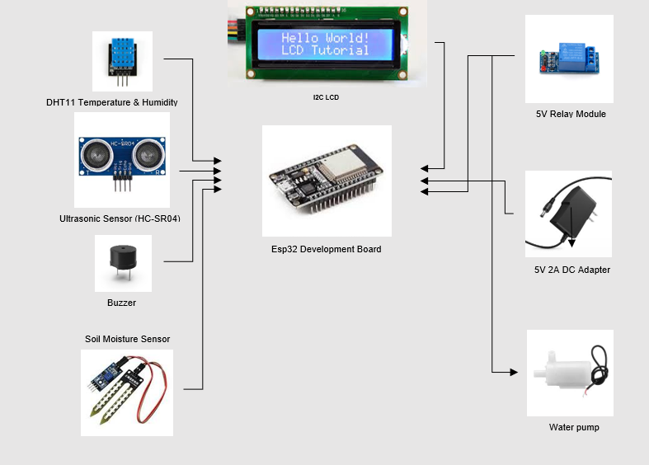
Research
Hardware Architecture:

Slide 8
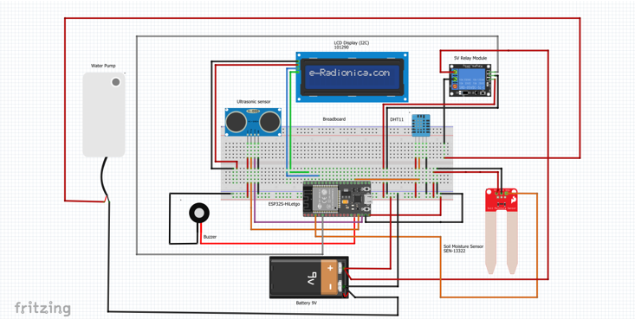
Research
Circuit Diagram:

Slide 9
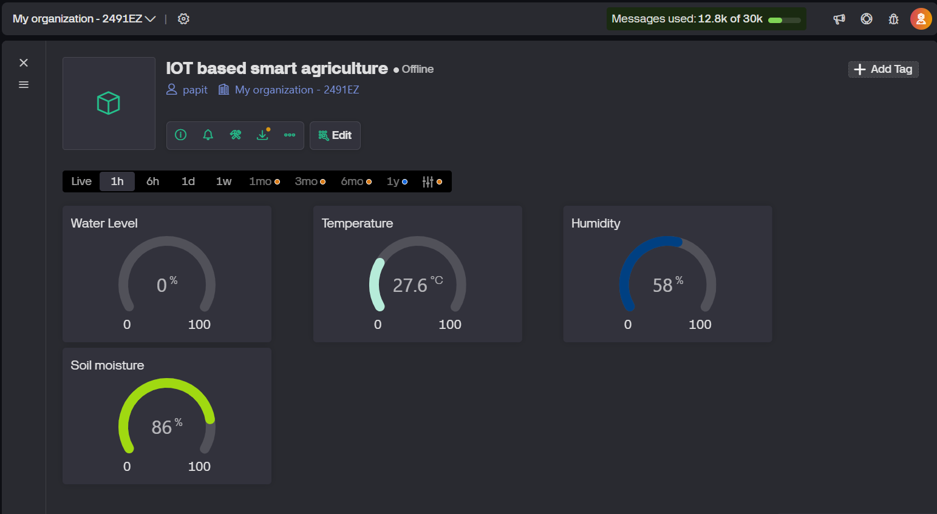
Research
Blynk:

Slide 10
Future Works
Further improvements include using advanced sensors(eg pH , rain sensors and AI based features like plant disease detection and adaptive decision-making . Solar panels can also be introduced to power the system sustainably, making it eco-friendly and ideal for remote or off-grid areas

Slide 11
Conclusion
The adoption of IoT in agriculture marks a transformative shift from traditional to smart farming by enabling real-time monitoring and data-driven decisions. It enhances irrigation efficiency, reduces manual labor, and improves resource management. Tools like Blynk allow remote monitoring, increasing convenience and minimizing crop loss due to unpredictable weather.
As seen in the case study, IoT systems significantly boost yield and sustainability. Looking ahead, integrating AI and renewable energy can further advance eco-friendly, efficient farming. This evolution ensures a more productive and sustainable future for global agriculture.

Slide 12
Any feedbacks…?

Slide 13
Thank You!

